Slide 1
The American Recovery and Reinvestment Act--2009
Congressional Budget Office—9/1/2012

Slide 2
Congressional Budget Office
Total Costs--$840 billion
Saved and Created 2.5 million jobs
Increased growth of the economy by 3.8 percent.
Kept unemployment from growing to 12 percent
Kept 7 million Americans from falling below the poverty line

Slide 3
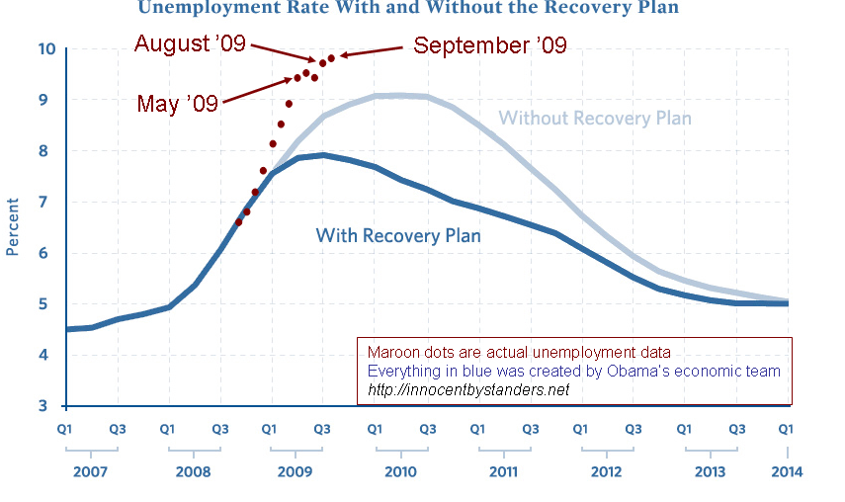

Slide 4
CBO
Increased spending for Medicaid, and food stamps.
$1.5 billion went to rent subsidies and emergency housing keeping 1.2 million in housing.

Slide 5
Enterprise Investment
Funded projects to switch medical records to digital.
$1 billion for effectiveness research on pharmaceuticals
Funded board band internet to thousands of rural communities
$90 billion to fund a variety of wind, solar and other clean energy projects (4% of these projects failed)

Slide 6
Enterprise
Funded subway, rail and bus expansions or upgrades in hundreds of cities.
Give almost all Americans a tax cut.
One section would have funded school construction projects in hundreds of cities. The Republicans vetoed this idea.

Slide 7
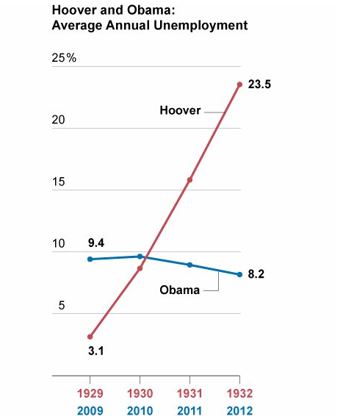

Slide 8
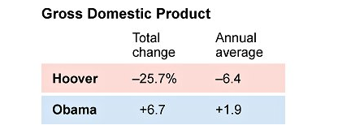

Slide 9
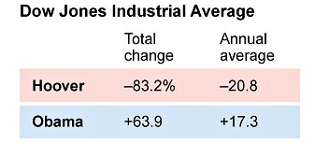

Slide 10
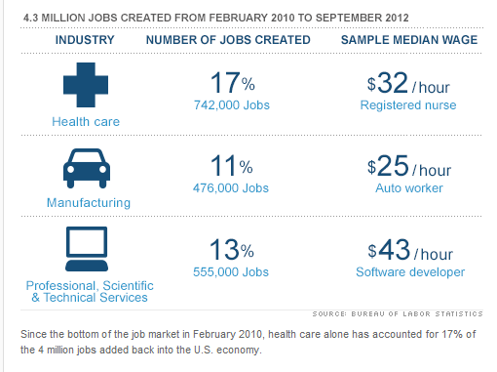

Slide 11
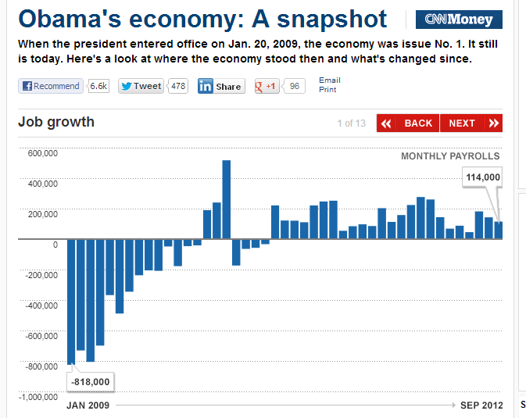

Slide 12
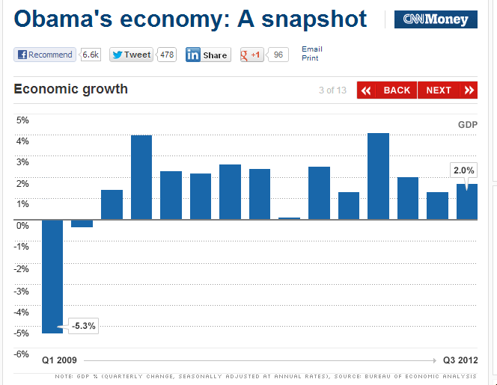

Slide 13
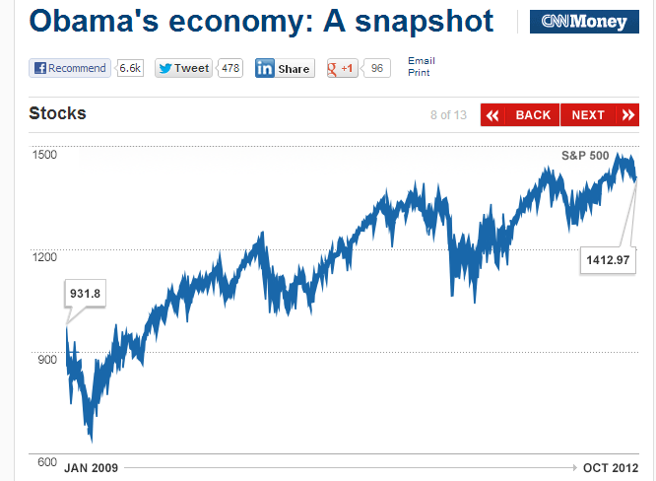

Slide 14
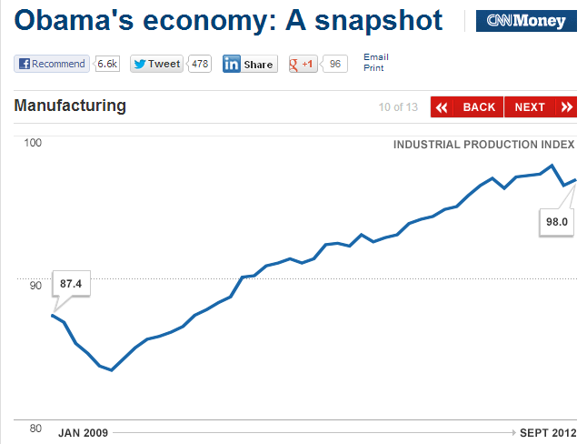

Slide 15
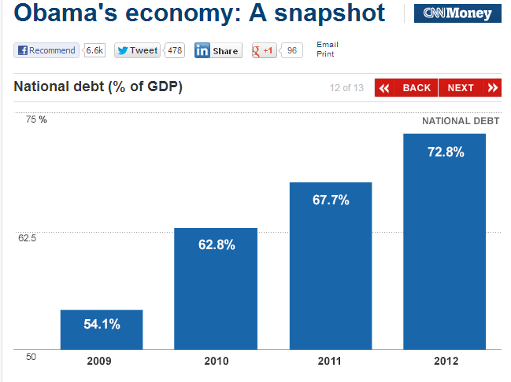

Slide 16
