Slide 1
Why is this topic important?
Crime has a major negative impact on our society in many ways.
Crime and incarceration have a negative impact on families and potential families which contributes to poverty.
People involved in crime and/or incarceration may never enter the mainstream, significantly reducing the number of viable partners, parents and contributing members of society.
The cost of crime to victims and society at large is very high, taking dollars that could be better spent.

Slide 2
The Amount of Crime in Communities and Societies speaks to:
Lack of supportive families
Poor neighborhood role models
Poor educational systems (failure factories)
A belief on the part of some people that crime is their best option
Often a culture that glorifies criminal lifestyles
Research shows that cultures matter

Slide 3
Crime
Crime is highly related to educational achievement.
Dropping out of high school is often a major sign of a life on the wrong track.
In Texas only about 60 percent of teens graduate from high school.
All the evidence shows that improving the high school graduation rate would significantly reduce crime in America.
High school graduation rates can be improved only by helping children get off to the right start and not letting them fall behind.

Slide 4
Popular culture also plays a role. It can promote quality values or dysfunctional and self-defeating values. Many critics believe that much of American popular culture (music, movies, video games, dress codes, speech patterns, etc.) promotes values that are extremely dysfunctional for young people.
Given how devastating crime and incarceration are for millions of families, critics question why there is so much tolerance for music, films, video games and people who promote dysfunctional culture.
(Could it be because companies like Sony make a lot of money on these products?)

Slide 5
Crime
America has the highest incarceration rate of any nation.
What does our incarceration rate say about America?
It speaks to how our culture defines crime, how we believe lawbreakers should be dealt with, and the ability of our nation to enforce its laws.
American incarceration rates are significantly impacted by our drug laws and the system of punishment in place to deal with drug users and dealers.
We are much tougher on some types of drug use than most other Western European nations.

Slide 6
Crime
Crime in America is also often different from crime in Western Europe, Scandinavia, and most Asian nations—it is much more violent (weapons are more often used).
Of course, some other countries also have very high rates of violence (African countries, Brazil and many other Latin American countries, Russia, etc.)
Our criminal justice system is very professional and effective. Many nations do not have well-trained, professional police or independent, competent, honest prosecutors and judges.
Some countries cannot even finance, or manage competent jails and prisons.

Slide 7
Punishing Criminals
We use jail or prison time more frequently than most of the European and Scandinavian nations.
One result of our high incarceration rate is that our criminal justice system is expensive—very expensive.
We spend a great deal more money on our system than any of the Western European or Scandinavian nations.

Slide 8
Incarceration Rates
As noted, America has the highest incarceration rate in the world. About one in every hundred adult Americans is in jail or prison.
About 5% of the world’s population lives in America, but about 25% of everyone in jail or prison is in America.
One in 15 black adults is in jail or prison.
One in nine black men between the ages of 20 and 34 is in jail or prison.
One in 36 Hispanic adults is in jail or prison.
At any given time some two million men and about 200,000 women are in prison or jail, while another large number are on probation or parole.

Slide 10
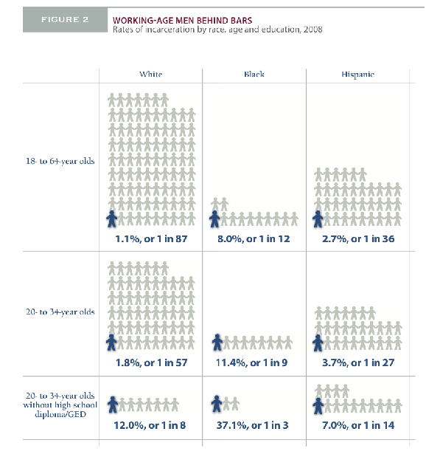

Slide 11
Increases on Incarceration Rates

Slide 12
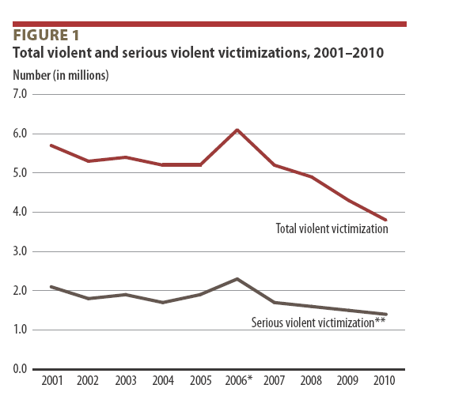

Slide 13
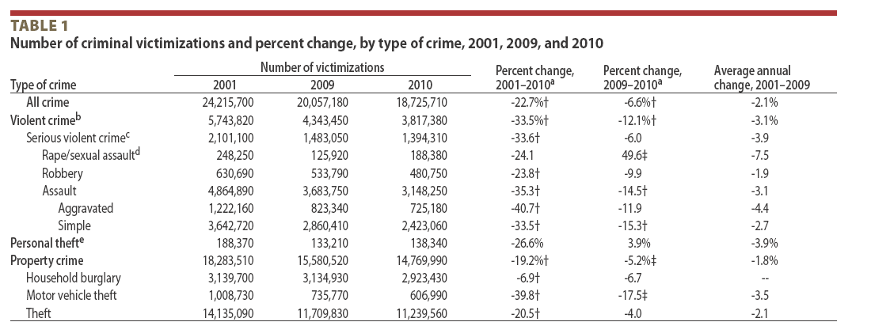

Slide 14
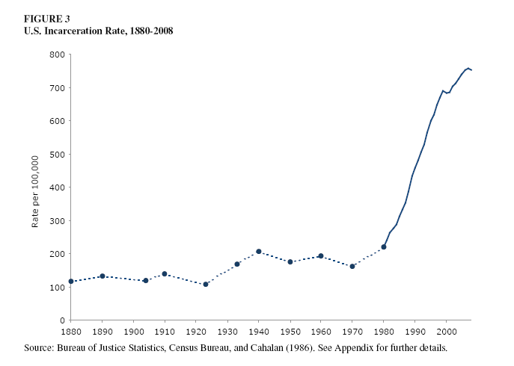

Slide 15
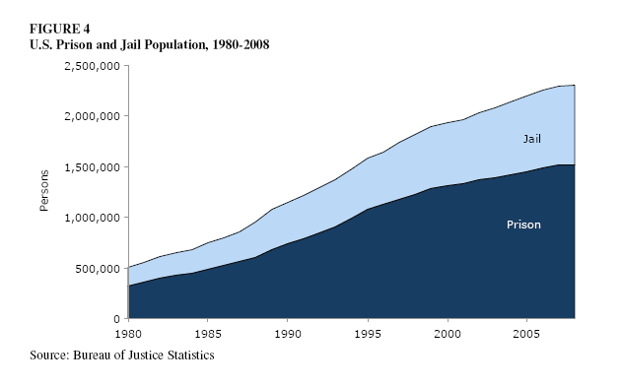

Slide 16
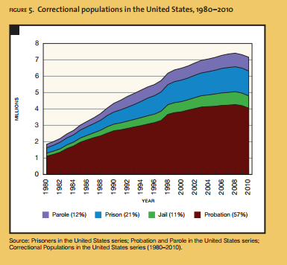

Slide 17
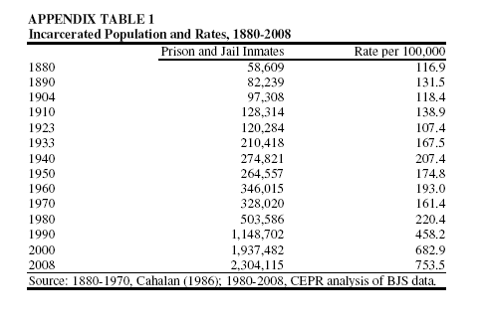

Slide 18
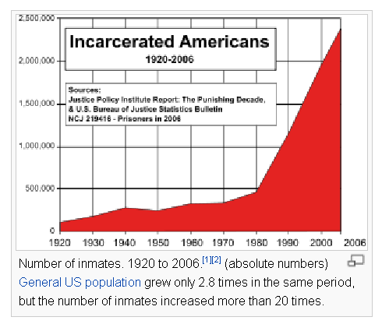

Slide 19
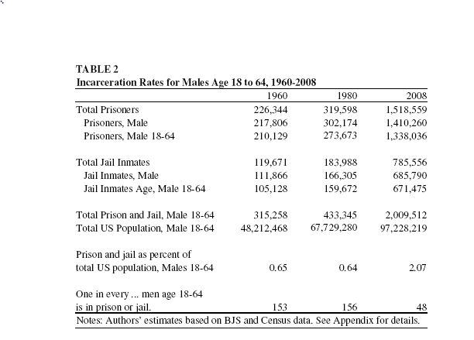

Slide 20
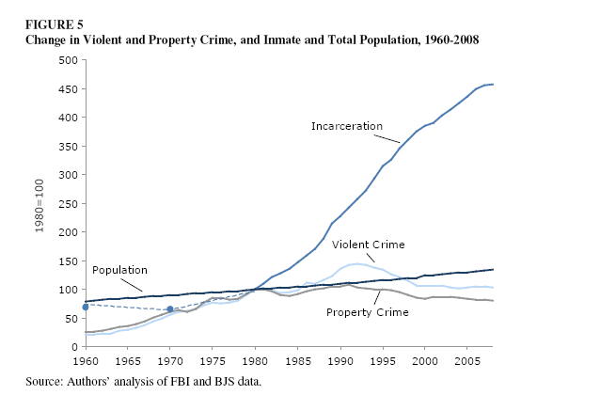

Slide 21
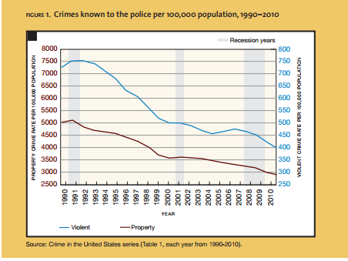

Slide 22
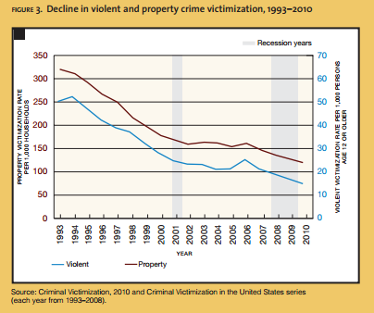

Slide 23
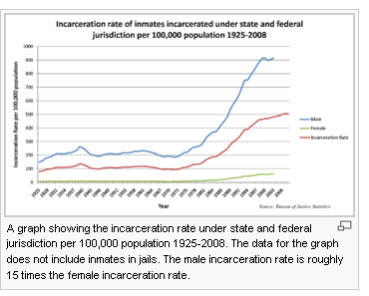

Slide 24
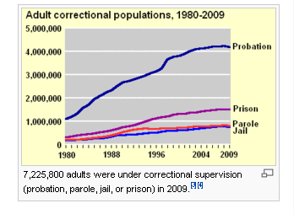

Slide 25
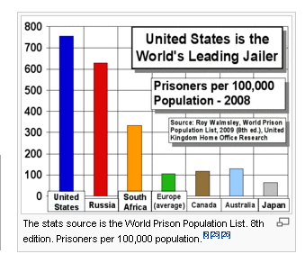

Slide 26
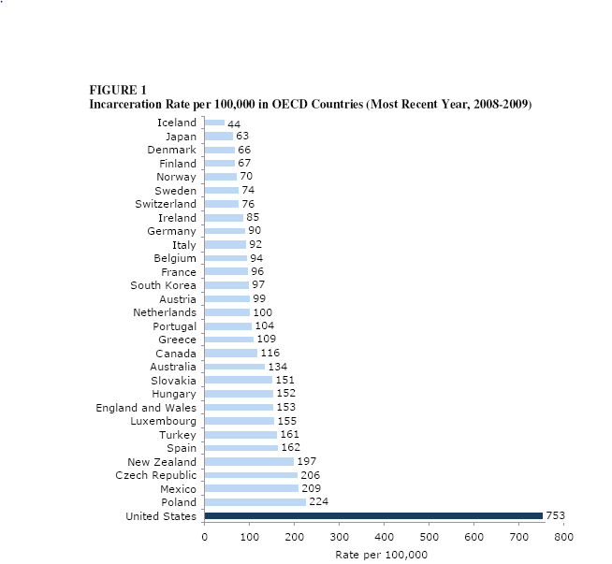

Slide 27
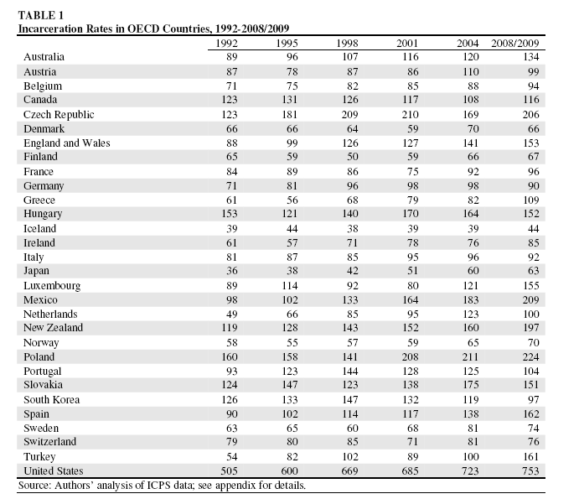

Slide 28
Western –Summary--Mass Imprisonment
The boom in imprisonment is significant, in part because of its effect on social equality.
Incarceration is concentrated among the disadvantaged and large race and class disparities in imprisonment reinforce lines of social disadvantage.
Ninety percent of all prison and jail inmates are men; most are relatively young.
Imprisonment is commonplace among young black men, more common than military service or college graduation.
Blacks and Hispanics together account for about two-thirds of the state prison population.

Slide 29
Black men are six to eight times more likely to be in prison than whites.
Garland: “for young black males in large urban centers, imprisonment has come to be a regular, predictable part of experience.”
If white men were incarcerated at the same rate as blacks there would be more than six million people in prison and jail, and the incarceration rate would include more than 5 percent of the male working-age population.
Generally, men entering prison will not be following typical life trajectories.
Ex-prisoners earn lower wages, suffer more unemployment, are less likely to get married or live with the mothers of their children.

Slide 30
It is particularly risky for young men to drop out of high school.
Young white men who drop out of high school have an 11% risk of imprisonment; along with 3.6% of those with a GED.
Young black men who drop out of high school have a 59% risk of imprisonment, along with 18.4% of those with a GED.

Slide 31
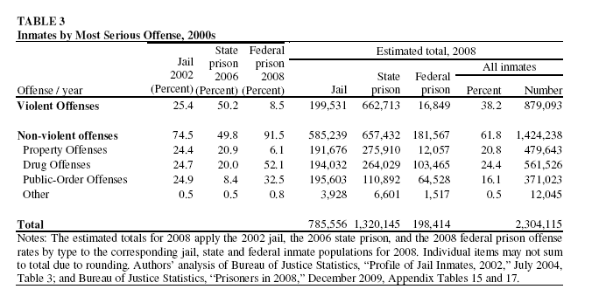
What Percent of Crimes are Violent?

Slide 32
Costs

Slide 33
Total Costs of Crime
The latest estimate by economists is that crime cost America about $1.7 trillion per year.
This includes the costs of police, jails, prisons, the criminal judicial system (including defense lawyers and defense teams paid by taxpayers), security systems installed by businesses, communities and property owners, loss productivity by victims and criminals, welfare costs, insurance costs, etc.
Housing prisoners is expensive, especially since there are so many people in our jails and prisons.
The states spend some $55 to $60 billion a year on prisons. In some states, the prison system is the fastest growing cost in the state budget.

Slide 34
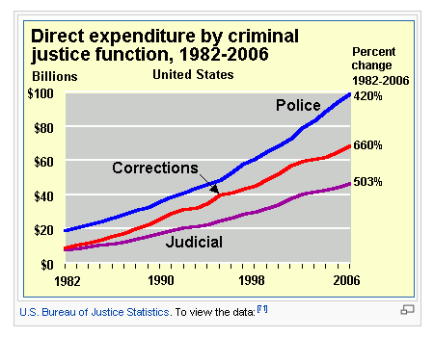

Slide 35
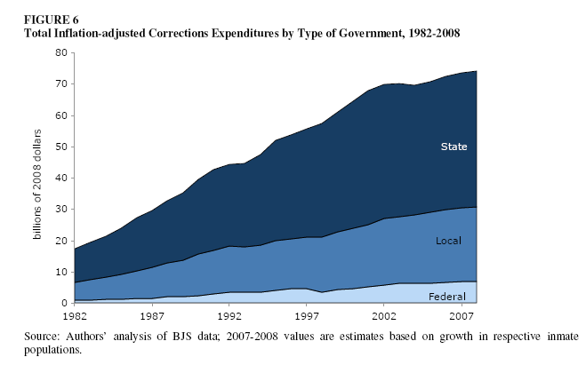

Slide 36
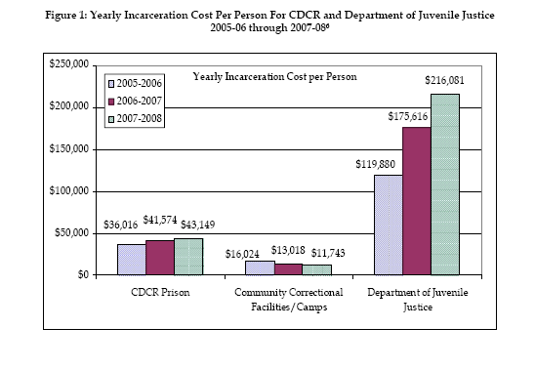

Slide 37
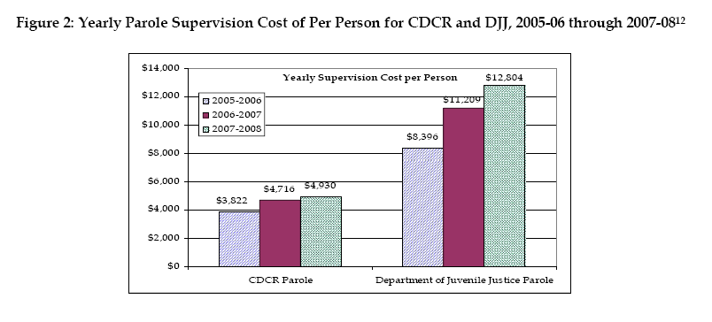

Slide 38
Costs of jail and imprisonment are so high that some states now require a cost estimate of punishment options for criminals before sentencing by judges or juries.
It is very hard to reduce costs. The basic infrastructure would remain in place even if the number of defendants and prisoners were reduced by 10 to 15 percent.
Costs drop considerably if crime can be reduced by 30% or more.

Slide 39
Costs of Crime Including Impact on Victims

Slide 40
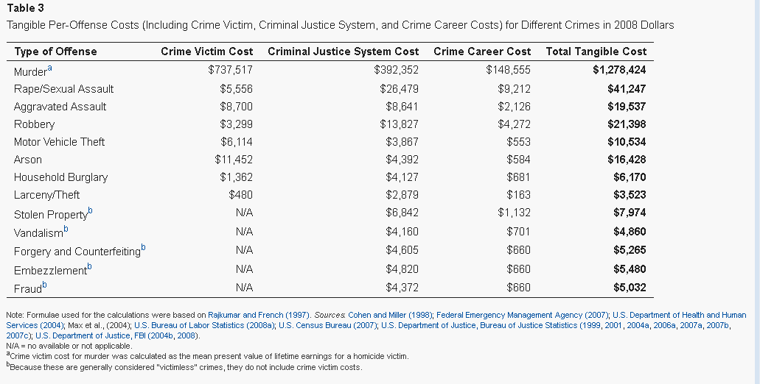

Slide 41
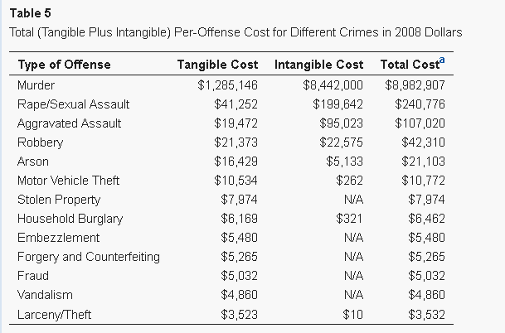

Slide 42
Cost Savings

Slide 43
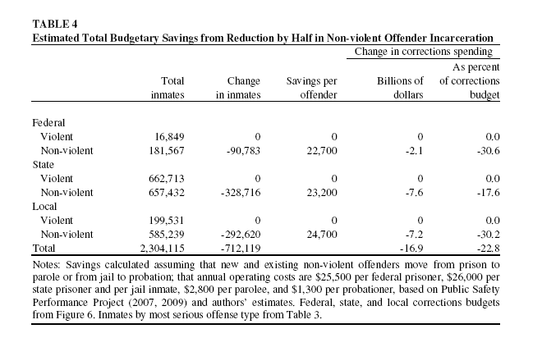

Slide 44
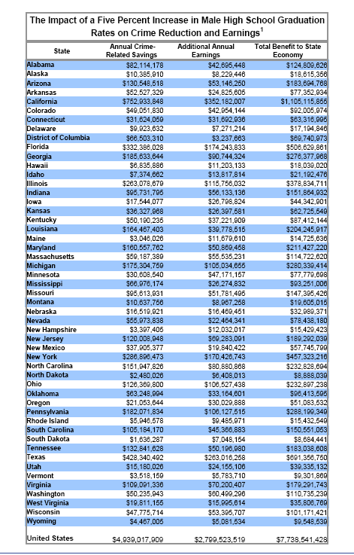

Slide 45
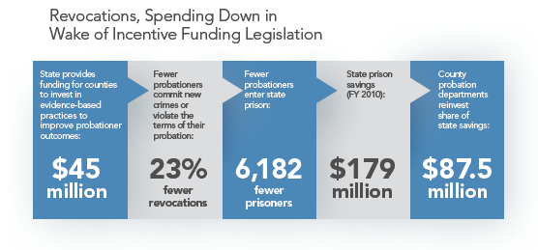

Slide 46
What Can be Done?
I. Cannot just open the prison gates, especially for violent criminals.
II. We can give some hard thought to our drug laws and our sentencing guidelines.
III. The Portugal Experiment: Decriminalized all drugs, but not drug trafficking. . Result:
Crime rates dropped, drug usage may have increased a small amount, addiction rates have not risen. Treatment programs were set up at the same time as drugs were decriminalized.
IV. We lock people up for offenses that other western nations deal with by fines, community service and medical care. We can rethink our approach.
V. More productive might be an emphasis on lowering the number of people susceptible to crime.
VI. Some argue that this means taking a hard look at our culture, especially the glorification of crime and violence.
VII. Doing a better job of educating children and lowering the high school dropout rate would clearly help.

