Slide 1
Social Welfare Challenges in the Immediate Future

Slide 2
I. Adapting the New Approach to Welfare (TANF)
The basic design will endure. The focus of welfare will be on moving the able-bodied adult poor into the workforce.
Most expenditures will be for services, not cash.
TANF reflects American philosophy. “A hand up, not a hand out.”
But one of TANF’s most serious flaws is that it is designed to work with a healthy employment market.
It has proven to be unresponsive to recessions, high rates of unemployment and sub-employment.

Slide 3
Problems with TANF
As the economy has weakened, many states have cut TANF expenditures and continued to reduce the number of families receiving help.
In good times or bad, employment support services are often weak or non-existent.
To improve on the positive impacts of the program, as people gain experience working, recipients need help in gaining better work skills and better jobs.
SNAP, school meal programs, and the EITC will continue to do a good job of reinforcing basic welfare programs.

Slide 4
Social Welfare
SSI will provide a base income for the disabled poor, while the EITC will supplement the income of low-income workers, especially those with children.
The largest public expenditures will continue to be Social Security (which hopefully will continue to be self-financed) and health care programs (which hopefully will be more efficient).

Slide 5
II. Dealing with Employment and Wage Problems
Wage growth has been stagnant for many years, for both middle-income and low-income workers.
A lot of part-time jobs and full-time jobs with very low pay and often no benefits.
Many jobs pay low wages that do not improve even at the rate of inflation or with employee seniority.
Many large corporations make high profits but pay most of their employees poverty wages—Starbucks, Sears, McDonalds, Burger King, Wal-Mart, KFC, Pizza Hut, Macys, Dillard's, etc.

Slide 6
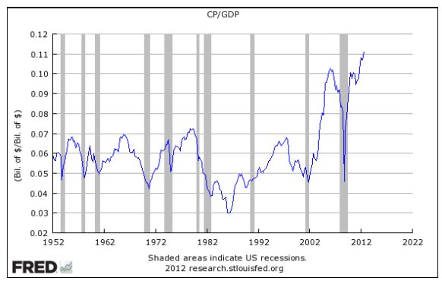
Corporate Profits as a Percentage of GDP

Slide 7
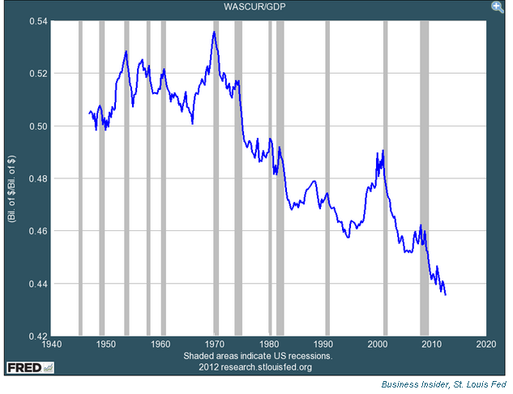
Wages as a Percent of GDP

Slide 8
III. Dealing with Demographic Changes
An aging population (true of all the Western Industrialized nations and much of Asia).
Family complexity: single-parenting, co-habitation, unstable non-married partnerships, and families with multiple-partner children. These types of families will probably grow as a percentage of all households and they tend to be economically vulnerable.
These environments create a lot of risk factors for children; including those that will be the next generation of poor.
Significant increases in single person households (aged and non-aged).
Significant increases in minority populations that are often low-income and in poor educational environments.
Think about Texas 30 years into the future and ask yourself if we are planning for the future.

Slide 9
IV. Improving Educational Outcomes
Real need to reduce structural discrimination by preparing a much larger proportion of the vulnerable population for the global employment market and the market of the future.
We seriously need to rethink how we educate youth and young adults for a changing world.
Success in educating young depends in part on recognizing how hard it is to do a good job of educating them.

Slide 10
Educational Outcomes
Focus on both cognitive and non-cognitive skills.
Universities will need to rethink their design and model. There is a considerable debate going on in academia about how universities of the future should be designed.
Provide better opportunities for non-college graduates to acquire employment skills and certifications.

Slide 11
V. Dealing with the Cost of Social Welfare and other Government Programs
Fixing Social Security (not very hard, but should be done sooner rather than later).
Getting a handle on health care costs (extremely hard, but critical).
Hopefully, the ACA is the beginning of a more cost effective and comprehensive health care system.
Success depends significantly on developing controls on expenditures driven by well-financed, sophisticated interest groups that are accustomed to large profits and high incomes.
Making the tax system fairer and more effective for citizens and businesses.

Slide 12
VI. Leveling the Playing Field In American Politics
Reduce the influence of well-financed groups in the political process and in the budget process.
You know the golden rule of politics: those with the gold make the rules.
You know the platinum rule: there are three things that are important in politics: the first is money and no one can remember the other two.
Basically this would mean creating competitive House districts, decreasing the role of money in congressional elections and perhaps term limiting members of Congress.
Controlling federal spending would be aided by giving the president a line item veto.

Slide 13
VII. Science will Impact our World and all these Issues
Science will impact our world and all these issues
Technological advances will greatly change our world and the planet’s labor markets.
Skill requirements will change and the nature of work will change.
In the future, we may not need the 40 hour work week.
Most people may need to retrain several times during their work life to stay competitive (which could have negative implications for pensions).
Critical advances in sustainable energy will be made along with major advances in computer chip size, power and speed.
Steve Jobs said “You haven’t seen anything yet.”
These changes will greatly change our world.

Slide 14
Science
Medical science will significantly improve human health and extend longevity.
Unless we live healthy while we live longer, we will have some real strains on our health care programs.
Advances in science will impact the type and degree of education the public needs, the public’s need for government assistance, and the cost of providing that assistance.
Nations that can adapt to a world that will be changed by demography, science and global markets will have the best chance of prospering.

