Slide 1
Hacker and Pierson: Winner take All Politics

Slide 2
America’s Economic and Political Stalemate
An economy in trouble—high unemployment, large deficits, low growth rates
A stalemate in Congress—unable to compromise on policies to address major problems
Cannot agree on budget cuts or revenue issues
A Republican presidential nomination process dominated by candidates with very small support groups.
Only two of the Republican candidates can appeal to the mainstream--Hunstman and Romney.
Serious economic crisis in Europe, especially among EU voting nations.
European problems impacting all major world markets, and the situation could get worse.

Slide 3
Basically focuses on three questions:
Why is America experiencing hyperconcentration of income and wealth?
Why is this hyperconcentration sustained?
Why are salaries and basic benefits (pensions, health care, job security) for the non-rich eroding?
They present the data on hyperconcentration and salary stagnation and discuss the loss of pensions, health care, and job security being suffered by millions of middle-class Americans.

Slide 4
Impact on Growth of the Economy
They also document that hyperconcentration of wealth and income has not produced a boom in the growth of the American economy.
In other words, tax cuts at the top that have enriched the top 10 percent and made a small percentage of the American public super rich has not resulted in a rapidly expanding economy.
Our growth rate is no better and sometimes worse than European and Scandinavian nations with a much more equal distribution of income and wealth.

Slide 5
The next question they raise is whether hyperconcentration is simply a natural result of any capitalist system?
Their answer is that it is unusual even among capitalist countries.
The next question they address is whether hyperconcentration is the result skill-based-technology change?
Is hyperconcentration simply the result of college educated people earning so much more than the poorly educated population?
That explanation does not hold because only a tiny proportion of the college educated is making extremely high incomes.

Slide 6
They turn to the frequently made argument that government does not and cannot play any role in the growth or distribution of income and wealth.
Hacker and Pierson dismiss this argument on three grounds:
They argue that it misses strong evidence that government is doing much less to reduce inequality through taxes.
It is based on the assumption that government aids hyperconcentration only when it passes laws supporting it. They argue that government policy often consist of “drift.”
The argument ignores laws governing unions, the minimum wage, subsidies and tax breaks for corporations, regulation of the financial sector, etc.

Slide 7
They point out that:
Taxes on the highest income groups keep dropping.
Government is doing less to reduce inequality and poverty policy is based on employment in a high-unemployment environment.
The minimum wage is not indexed to the rate of inflation.
It has not, in other words, been indexed to reflect changes in the rising price of consumer goods.

Slide 8
Government policies and inaction have made it easier for businesses to attack unions, and made it harder for workers to form and join unions.
Government has bailed out too-big-to fail banks, Wall Street and large insurance companies with public dollars when their risky, and often illegal, practices have caused economic calamity.
The result, they argue, allows banks and Wall Street to privatize profits while socializing losses.
When some members of Congress and the executive branch wanted to regulate the investment practices of big banks and Wall street in an effort to avoid another financial crisis, the banks and Wall Street used taxpayer provided funds to hire an army of over 1100 lobbyist to fight any regulation of their practices.

Slide 9
Hacker and Pierson turn to the proper role for government
Markets, they argue, are important but they under-produce or fail to produce “public goods.”
Public goods are shared, and include unpolluted air, safe streets, a system of law and justice, highway and transportation systems, national security, the just treatment of workers, quality products, and the fair distribution of economic rewards.

Slide 10
Next they ask the question: What has changed in the American political system that would give the rich and major corporations so much power?
Their answer is that the rich and big business have learned that money buys political influence. (Abramoff).
There is an old joke among politicians. “There are two things that are important in politics. One is money. No one can remember the second one.”
The rich and corporations have learned that money plays the major role in combat between organized groups.

Slide 11
Political conflict is more about policy than about elections.
Once elections are over, the winners can be influenced by money.
The rich and corporations have learned to invest money in Washington- based lobbying groups that can wage high-price battles on their behalf, 365 days a year.

Slide 12
These groups can pour millions and millions of dollars into election campaigns, and public relations campaigns through the media, newspapers, magazines, television.
They can fund opponents of politicians they disagree with, hire firms to write books and articles for magazines and newspapers, and even fund large cable networks (e.g. Fox News).
Organized groups have winning habits. They learn from experience, sustain a focus for decades, wait, watch, plan and then seize opportunity when the time is right.

Slide 13
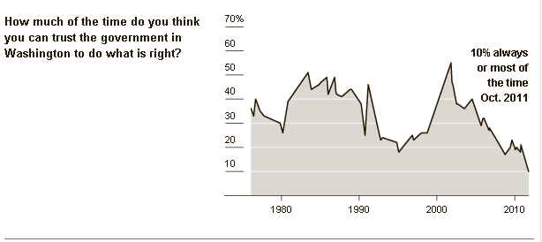

Slide 14
What Happened to Labor?
Hacker and Pierson turn to two new questions: Why has organized labor declined, and what has been the role of unions?
Unions expanded greatly during WWII. They played a very important role in seeing that men and women returning home after WWII were treated fairly.
They joined with the American Legion to make sure that veterans received benefits and jobs. Both groups were critical in passing the GI Bill.
The southern members of Congress had reservations because they did not want returning black veterans to receive benefits.

Slide 15
Unions
The unions played an important role in recruiting political candidates, funding elections, providing volunteers, and turning out voters on Election Day.
The powerful lobbies funded by corporations and the wealthy focused their efforts on reducing labor’s role.
They convinced Congress to pass laws that made it harder for unions to organize and operate, and cast labor as nothing more than a special interest group representing a small sector of workers.

Slide 16
Unions
As many labor unions cast their lot with the Republican party, the Democrats abandon them.
As the Unions have declined, other groups have formed. On the left there is EMILY’ List, which focuses on the priorities of more affluent women.
On the right there are the Christian Conservatives.
The Christian Conservatives have aligned a large block of evangelical voters whose incomes are generally modest with a political party highly attuned to the economic demands of the wealthy.

Slide 17
The Working Class
This means that Republicans attract far more support from lower and middle income voters than they would otherwise.
They are often called Sam’s Club Republicans.
“Citizens with lower and moderate incomes speak with a whisper that is lost on the ears of inattentive government officials, while the advantaged roar with a clarity and consistency that policymakers readily hear and routinely follow.”

Slide 18
Support for Government
Bartels: voters operating on their own have a hard time coming to clear judgments about what to demand from Washington and how to hold politicians accountable.
Conservative Egalitarians (Jacobs and Page):
On the conservative side they worry about government waste, dominance of special interests, and distrust public officials.
On the egalitarian side they are concerned about inequality of income, wealth, opportunity, and generally supportive of measures to address inequality, insecurity, and hardship.

Slide 19
Christian Conservatives
Christian Conservatives:
“Religious right has served as the shock troops for a party committed to a business agenda.”
In addition to abortion and civil rights, an issue that has galvanized the religious right has been financial support for Christian K-12 schools.

Slide 20
Polarization
Research by political scientist has shown that “over the past thirty years the parties in Congress have deserted the center of the floor in favor of the wings.”
Members of Congress and state legislatures draw congressional districts and they design them to keep their seat safe.
This produces “safe seats” that allow members of be either very conservative or very liberal.
Most Americans, on the other hand, are just not that far apart in their views.
Most Americans, of course, have limited political knowledge and voter turnout is low.

Slide 21
Why Can’t Democrats Advance Social Policies for the Working Class?
Hacker and Pierson’s argument is that they lack the organization, money, and media influence to challenge powerful economic interests, and many Democrats have been willing to accede to, or even cosponsor Republicans initiatives to support the winner-take-all economy.
“Increasingly in the 1980s the Democrats lost their capacity to speak to the economic concerns of the little guy.”

Slide 22
Reactions on the Right
Phil Gramm’s Diagnosis:
The collapse of the economy in 2007 he dismissed as a “mental recession and groused that the country was becoming a nations of whiners.”
Gramm argued that it was not predatory lending that caused the recession but instead predatory borrowers who could not pay their mortgages.
Gramm described Wall Street as “a holy place.”

Slide 23
Gingrich
Gingrich:
“Nothing is more important in the face of a war than cutting taxes.”
Gingrich supported the end of Social Security, no effective minimum wage, no progressive taxation, no employer-sponsored health care, almost no regulation of businesses, including banks and Wall Street.

Slide 24
The Job Market

Slide 25
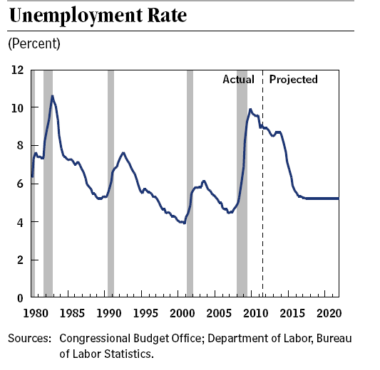

Slide 26
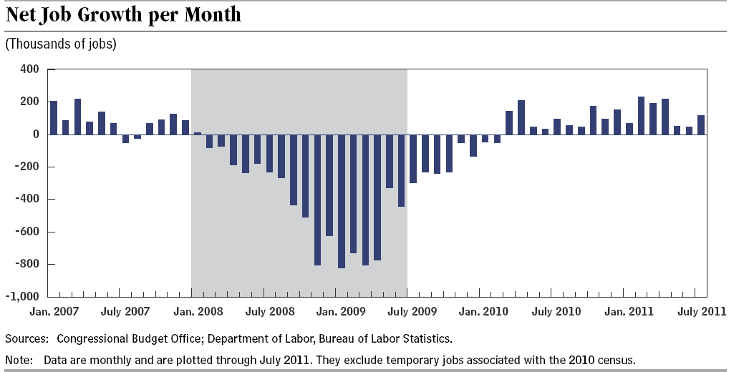

Slide 27
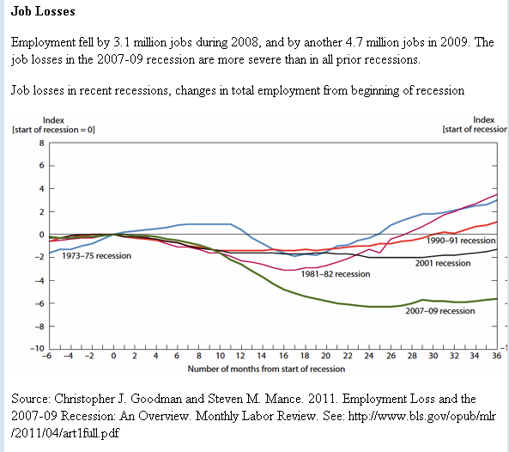

Slide 28
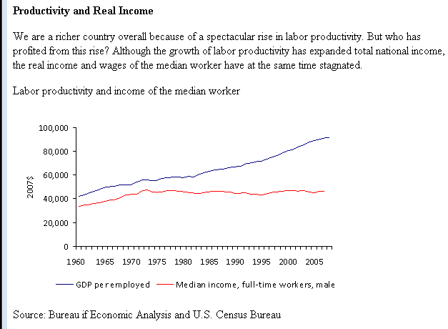

Slide 29
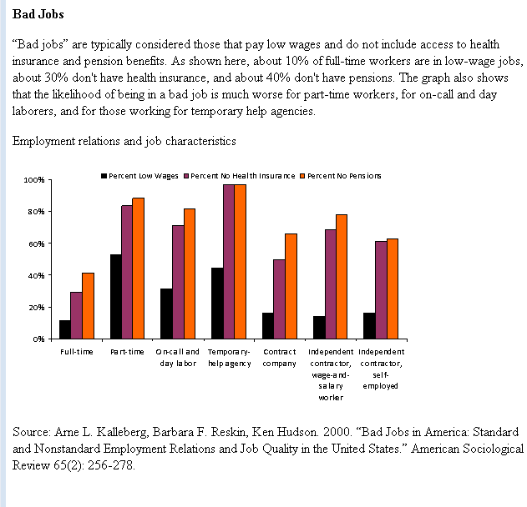

Slide 30
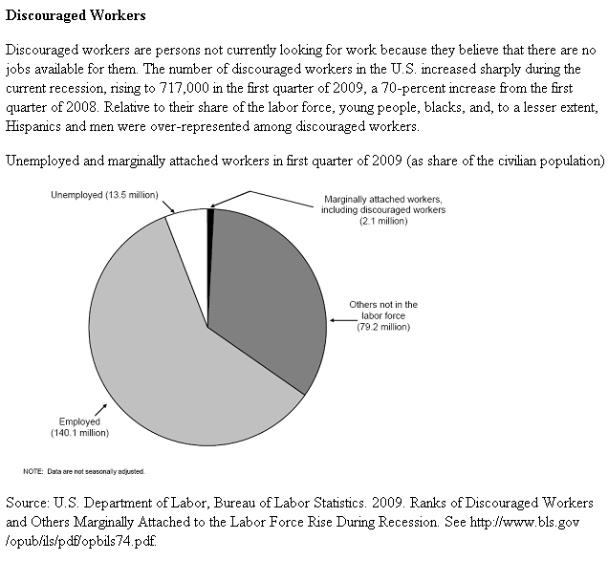

Slide 31
The Federal Budget

Slide 32
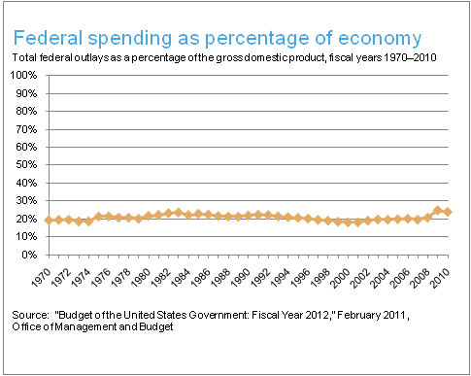
Federal Spending as Percentage of the Economy

Slide 33
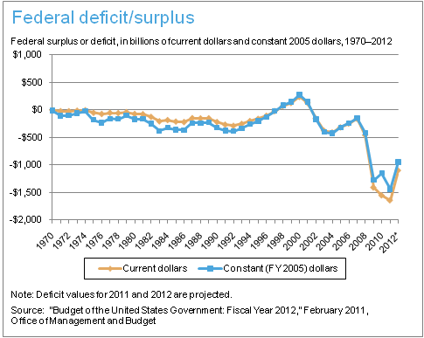
Federal Deficit/Surplus

Slide 34
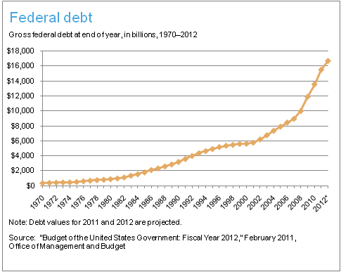

Slide 35
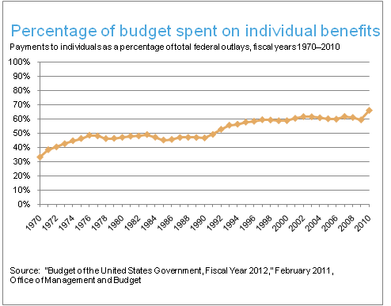
Percentage of Budget Spend on Individual Benefits

Slide 36
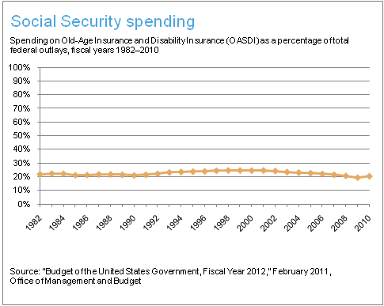
Social Security Spending

Slide 37
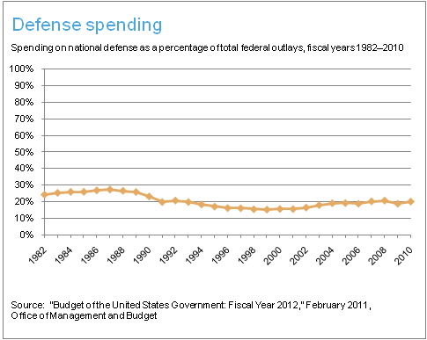
Defense Spending

Slide 38
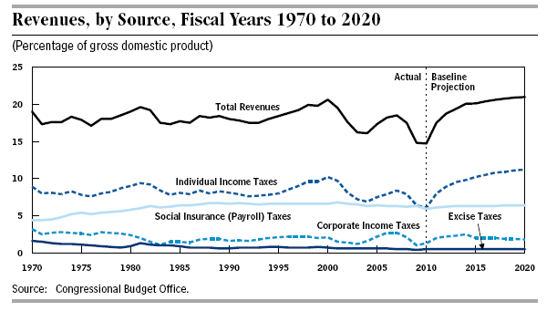

Slide 39
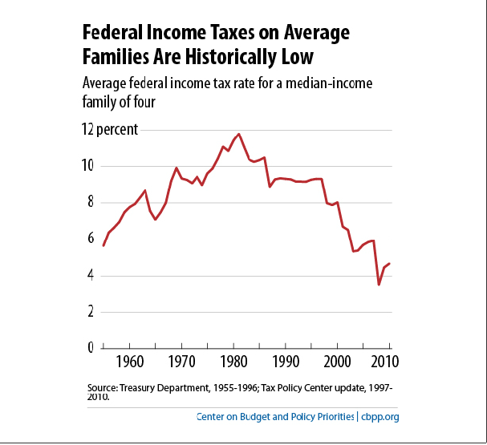

Slide 40
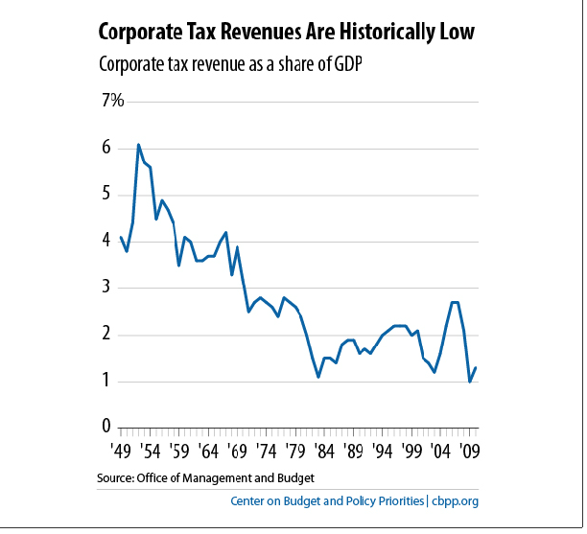

Slide 41
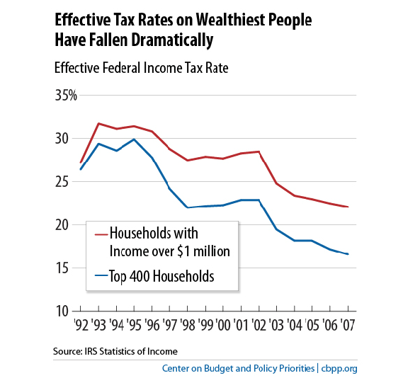

Slide 42
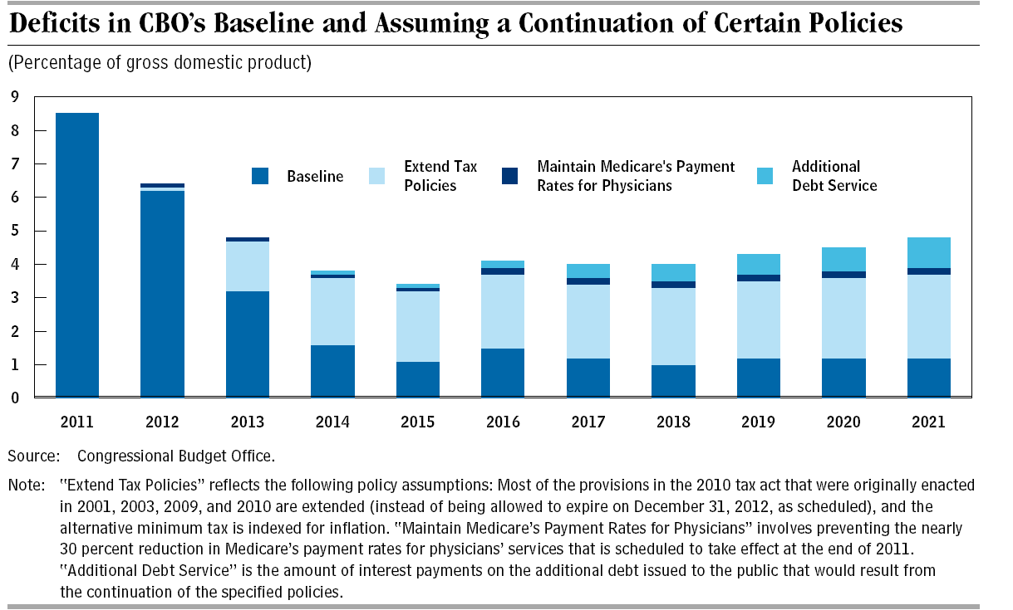

Slide 43
Public Views of Inequality

Slide 44
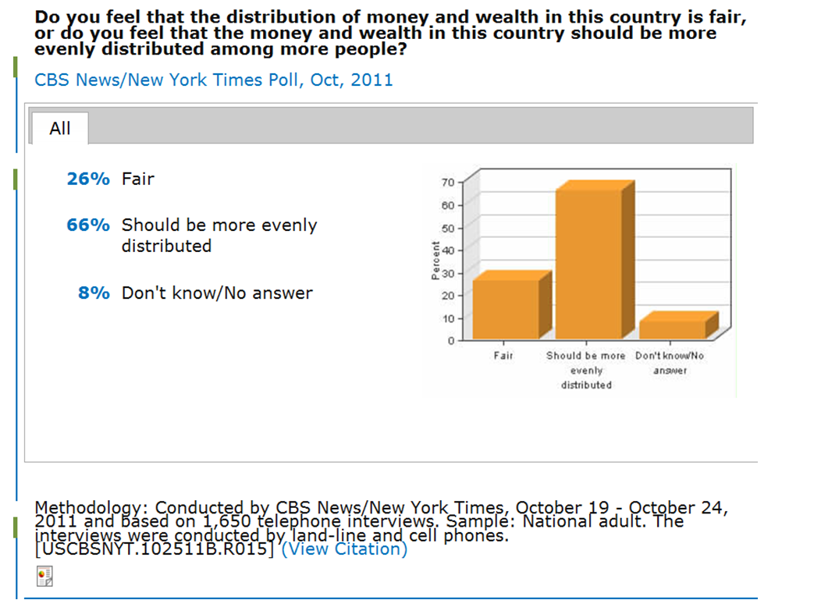

Slide 45
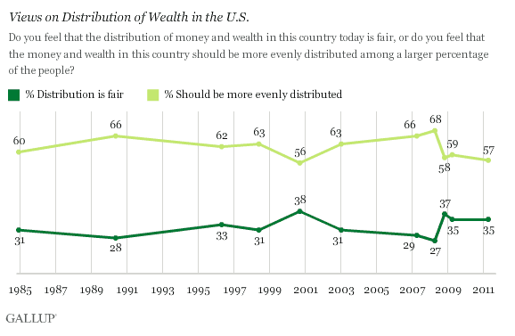
Gallup

Slide 46
Who Is to Blame?

Slide 47
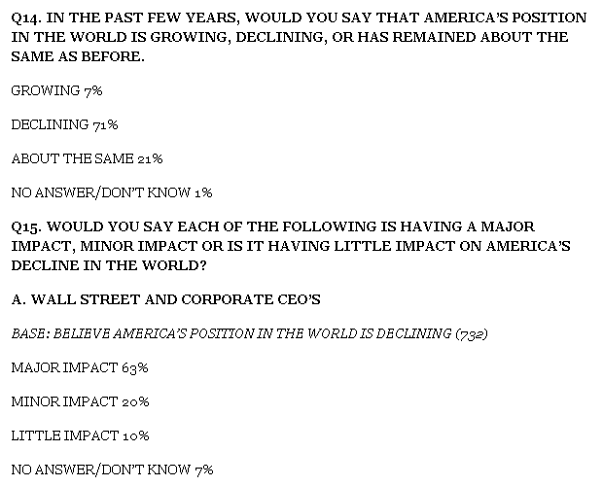
Time/ABT October 9-10, 2011

Slide 48
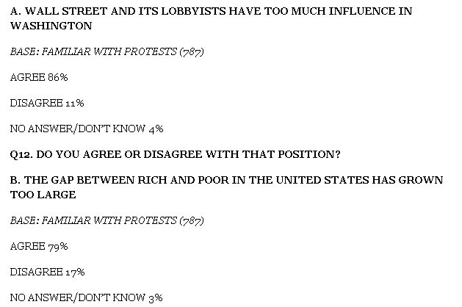
Time/ABT October 9-10, 2011

Slide 49
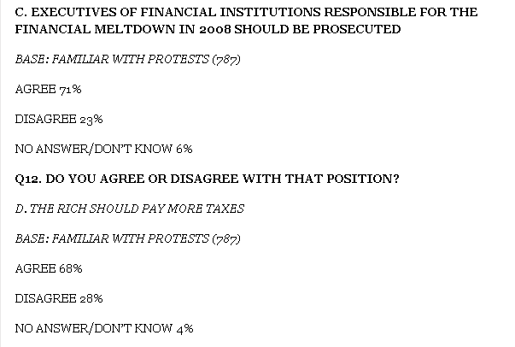
Time/ABT October 9-10, 2011

Slide 50
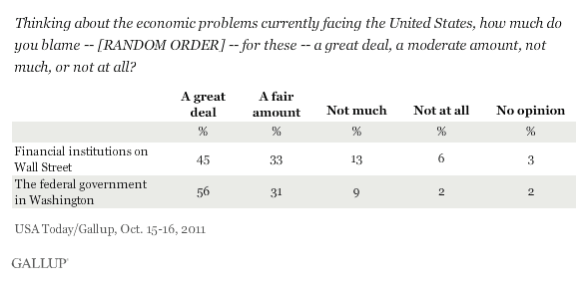
Gallup

Slide 51
Solutions

Slide 52
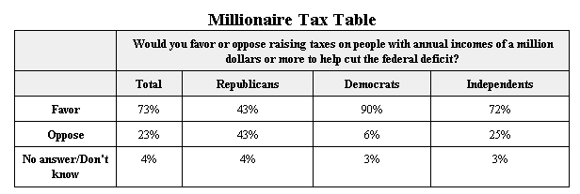
Time/ABT October 11, 2011

Slide 53
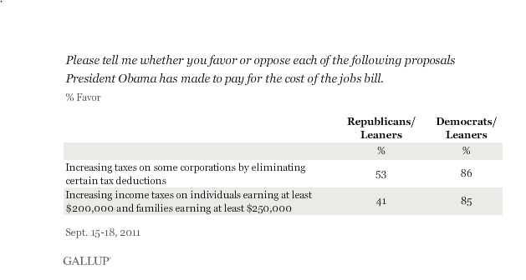
Gallup

Slide 54
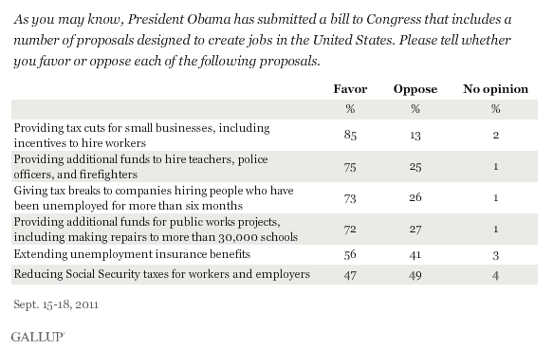
Gallup

Slide 55
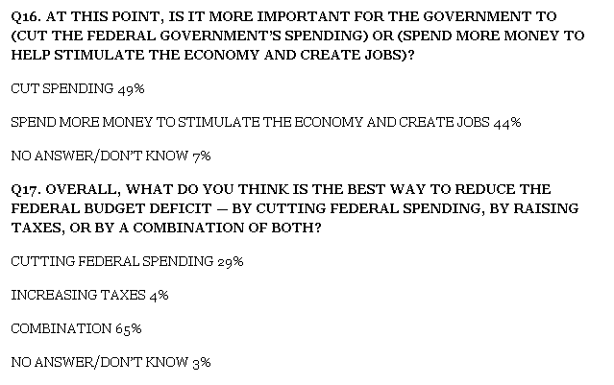
Time/ABT October 9-10, 2011

Slide 56
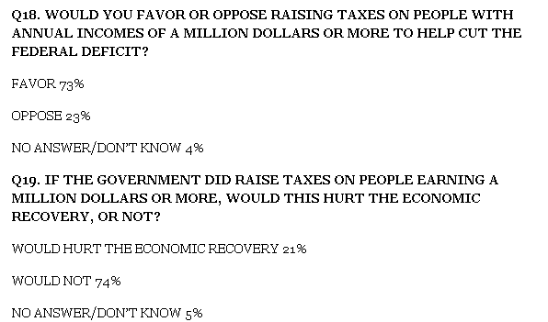
Time/ABT October 9-10, 2011

Slide 57
Waste

Slide 58
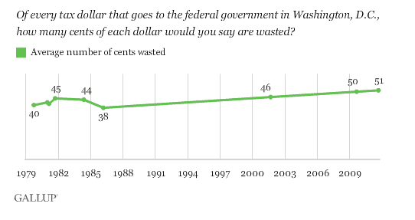
Gallup

Slide 59
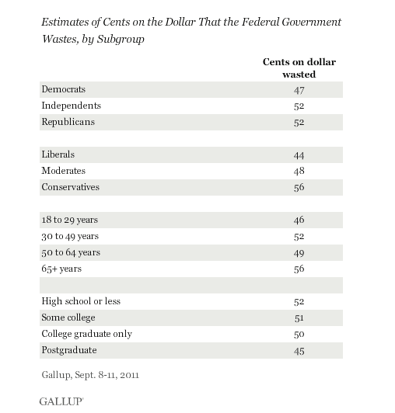

Slide 60
Attitudes Toward Occupy Wall Street and the Tea Party

Slide 61
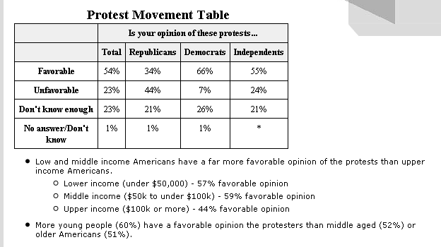
Time/Abt October 11, 2011

Slide 63
Time/ABT October 11, 2011

Slide 64
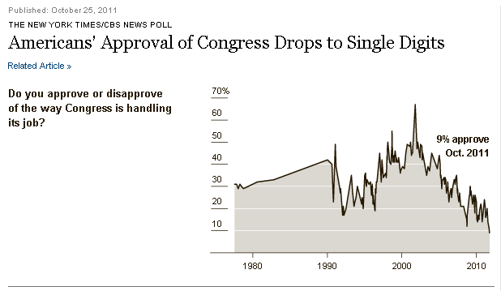

Slide 65
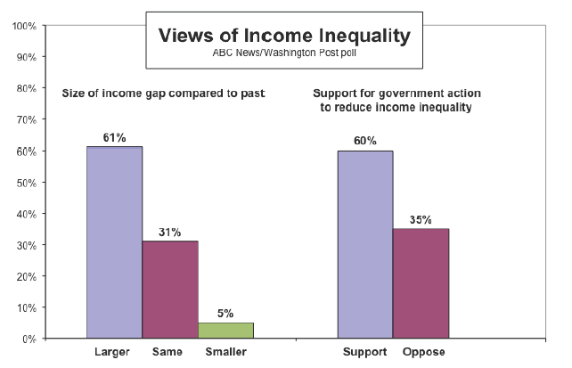
Six in Ten support Reducing Income Inequality

Slide 66
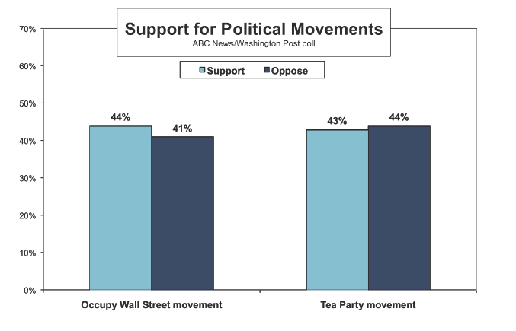
Support for Movements

